Slide 1
CYBERSECURITY INTERNSHIP
WEEK 1 ASSIGNMENT
NETWORKING FUNDAMENTALS
Submitted By: Akash Sanuria
Intern ID: DG/SEPTEMBER/CYBER/171
DG Interns Hub
DG Interns Hub | Cybersecurity Internship | Week 1 1

Slide 2
Week 1: What I Learned
• OSI Model – 7 layers
• TCP/IP Model – 4 layers and OSI comparison
• HTTP/HTTPS, FTP, DNS and DHCP
• IP addressing, public/private IP and basic subnetting
• Windows network commands: ipconfig, ping, tracert
• Cisco Packet Tracer: PC → Switch → Router
DG Interns Hub | Cybersecurity Internship | Week 1 2

Slide 3
Task 1 — OSI Model
Seven layers of network communication
Layer | Name | Main Function
7 | Application | Network services for user applications
6 | Presentation | Formatting, encryption, compression
5 | Session | Starts, manages and ends sessions
4 | Transport | End-to-end delivery; TCP/UDP
3 | Network | IP addressing and routing
2 | Data Link | Frames and MAC addresses
1 | Physical | Transmits bits through media
Example: Browser → TCP delivery → IP routing → Ethernet/Wi-Fi transmission
DG Interns Hub | Cybersecurity Internship | Week 1 3

Slide 4
Task 2 — TCP/IP Model
4 layers and comparison with OSI
TCP/IP Layer | Function | OSI Mapping
Application | Network services for applications | Application + Presentation + Session
Transport | Communication using TCP or UDP | Transport
Internet | IP addressing and routing | Network
Network Access | Local and physical transmission | Data Link + Physical
• OSI is a 7-layer reference model.
• TCP/IP is a 4-layer practical networking model.
• Some OSI layers are combined in TCP/IP.
DG Interns Hub | Cybersecurity Internship | Week 1 4

Slide 5
Task 3 — Common Network Protocols
Protocol | Purpose | Port(s) | Example Use
HTTP / HTTPS | Web communication; HTTPS is encrypted | 80 / 443 | Websites & web apps
FTP | File transfer | 20 / 21 | Upload/download files
DNS | Domain name → IP address | 53 | Finding google.com IP
DHCP | Automatic network configuration | UDP 67 / 68 | Automatic IP assignment
• HTTP/HTTPS = Web
• FTP = File transfer
• DNS = Name to IP
• DHCP = Automatic IP/network settings
DG Interns Hub | Cybersecurity Internship | Week 1 5

Slide 6
Task 4 — IP Addressing & Basic Subnetting
• IPv4 identifies a device on a network (example: 192.168.1.10).
• Public IP: used/routable on the public Internet.
• Private IP: used inside local networks.
• Private ranges: 10.0.0.0/8, 172.16.0.0/12, 192.168.0.0/16.
• Subnetting divides a network into smaller subnetworks.
• 255.255.255.0 = /24 → 256 total addresses, 254 usable hosts.
DG Interns Hub | Cybersecurity Internship | Week 1 6

Slide 7
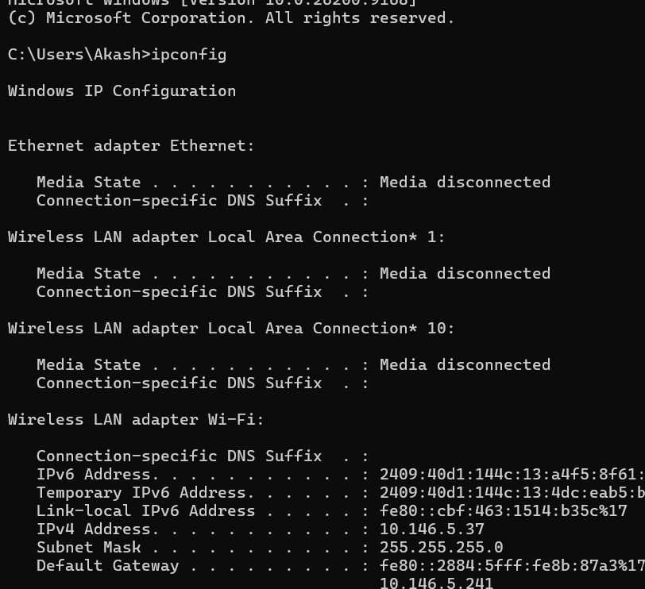
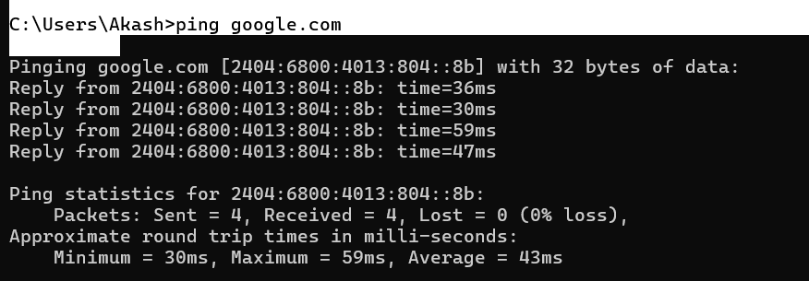
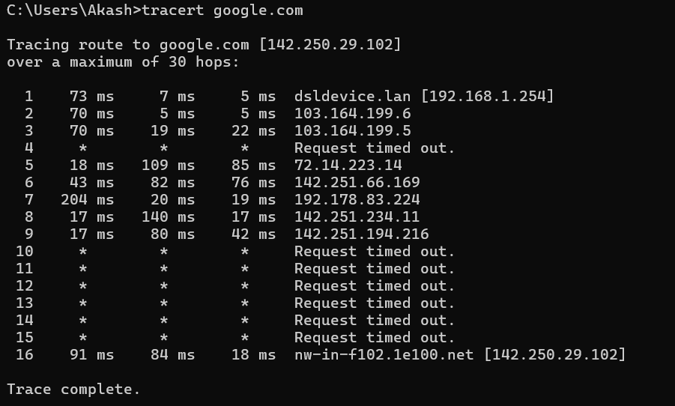
Task 5 — Windows Network Commands
Practical work performed on my own laptop
ipconfig
ping google.com
tracert google.com
Result: Ping test received 4/4 packets with 0% loss; tracert successfully reached the destination.
DG Interns Hub | Cybersecurity Internship | Week 1 7

Slide 8
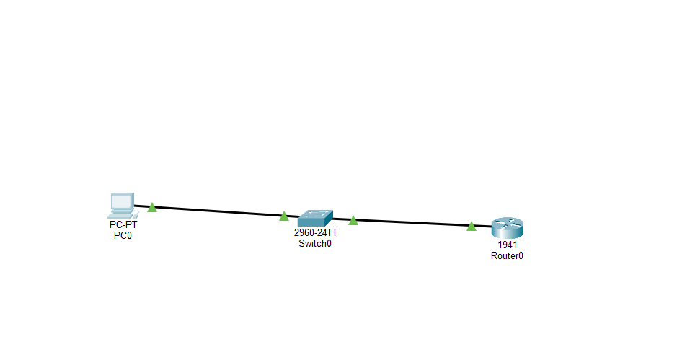
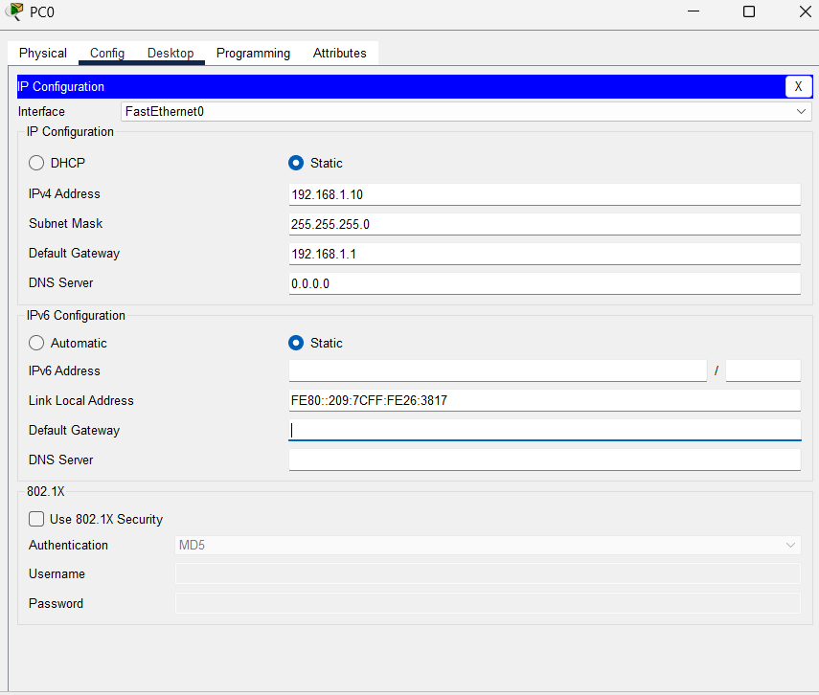
Task 6 — Cisco Packet Tracer
PC0 → Switch0 → Router0
• PC0 IP: 192.168.1.10
• Subnet Mask: 255.255.255.0
• Default Gateway: 192.168.1.1
• Router0 IP: 192.168.1.1
• Copper Straight-Through cables used
DG Interns Hub | Cybersecurity Internship | Week 1 8

Slide 9
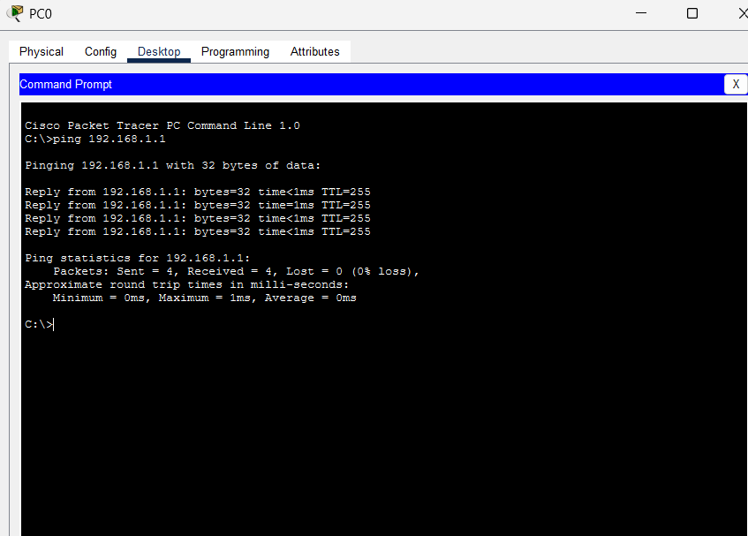
Packet Tracer — Connectivity Verification
• Command: ping 192.168.1.1
• Packets sent: 4
• Packets received: 4
• Packets lost: 0
• Packet loss: 0%
• Conclusion: PC0 successfully communicated with Router0.
DG Interns Hub | Cybersecurity Internship | Week 1 9

Slide 10
Key Learnings & Conclusion
• Understood how OSI and TCP/IP models organize communication.
• Learned the role of common networking protocols.
• Understood public/private IP addressing and /24 subnetting.
• Practiced real diagnostic commands on Windows.
• Built and configured a working Packet Tracer network.
• Verified connectivity with a successful 0% packet-loss ping test.
Week 1 Networking Fundamentals — Completed
DG Interns Hub | Cybersecurity Internship | Week 1 10

